Slide 1



Festive Flourish: Analysing AtliQ Mart's Diwali 2023 & Sankranti 2024 Promotions
Presented by
Sachin Kumar
AKA Peter Pandey

Slide 2
Problem Statement
AtliQ Mart is a retail giant with over 50 supermarkets in the southern region of India.
There was a promotion campaign during the Diwali 2024 and Sankaranti 2024 on their AtliQ branded products.
With that we want to understand which promotions did well and which did not so that they we make informed decisions for our next promotional period.

Slide 3


Ad-Hoc Business Requests

Slide 4
Business Request 1
Out of all the products in Atliq mart only Double Bedsheet set, and waterproof Immersion Rod are high-valued products that are currently being heavily discounted.
Product code | Product name | Base price | Promo type
P08 | Atliq Double Bedsheet set | 1190 | BOGOF
P14 | Atliq waterproof Immersion Rod | 1020 | BOGOF

Slide 5
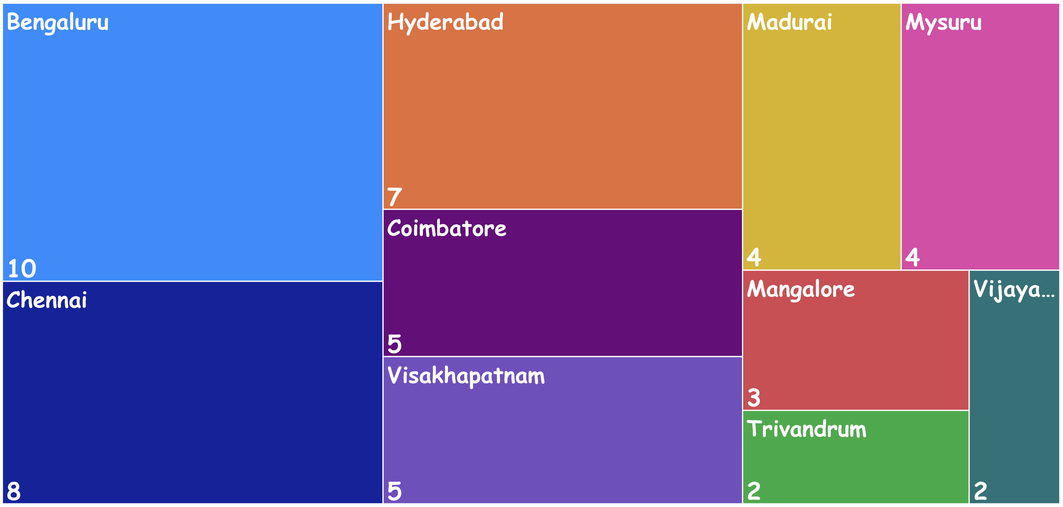
Business Request 2
This is the order in which cities with highest store presence.
city | Number of Stores
Bengaluru | 10
Chennai | 8
Hyderabad | 7
Visakhapatnam | 5
Coimbatore | 5
Madurai | 4
Mysuru | 4
Mangalore | 3
Trivandrum | 2
Vijayawada | 2

Slide 6
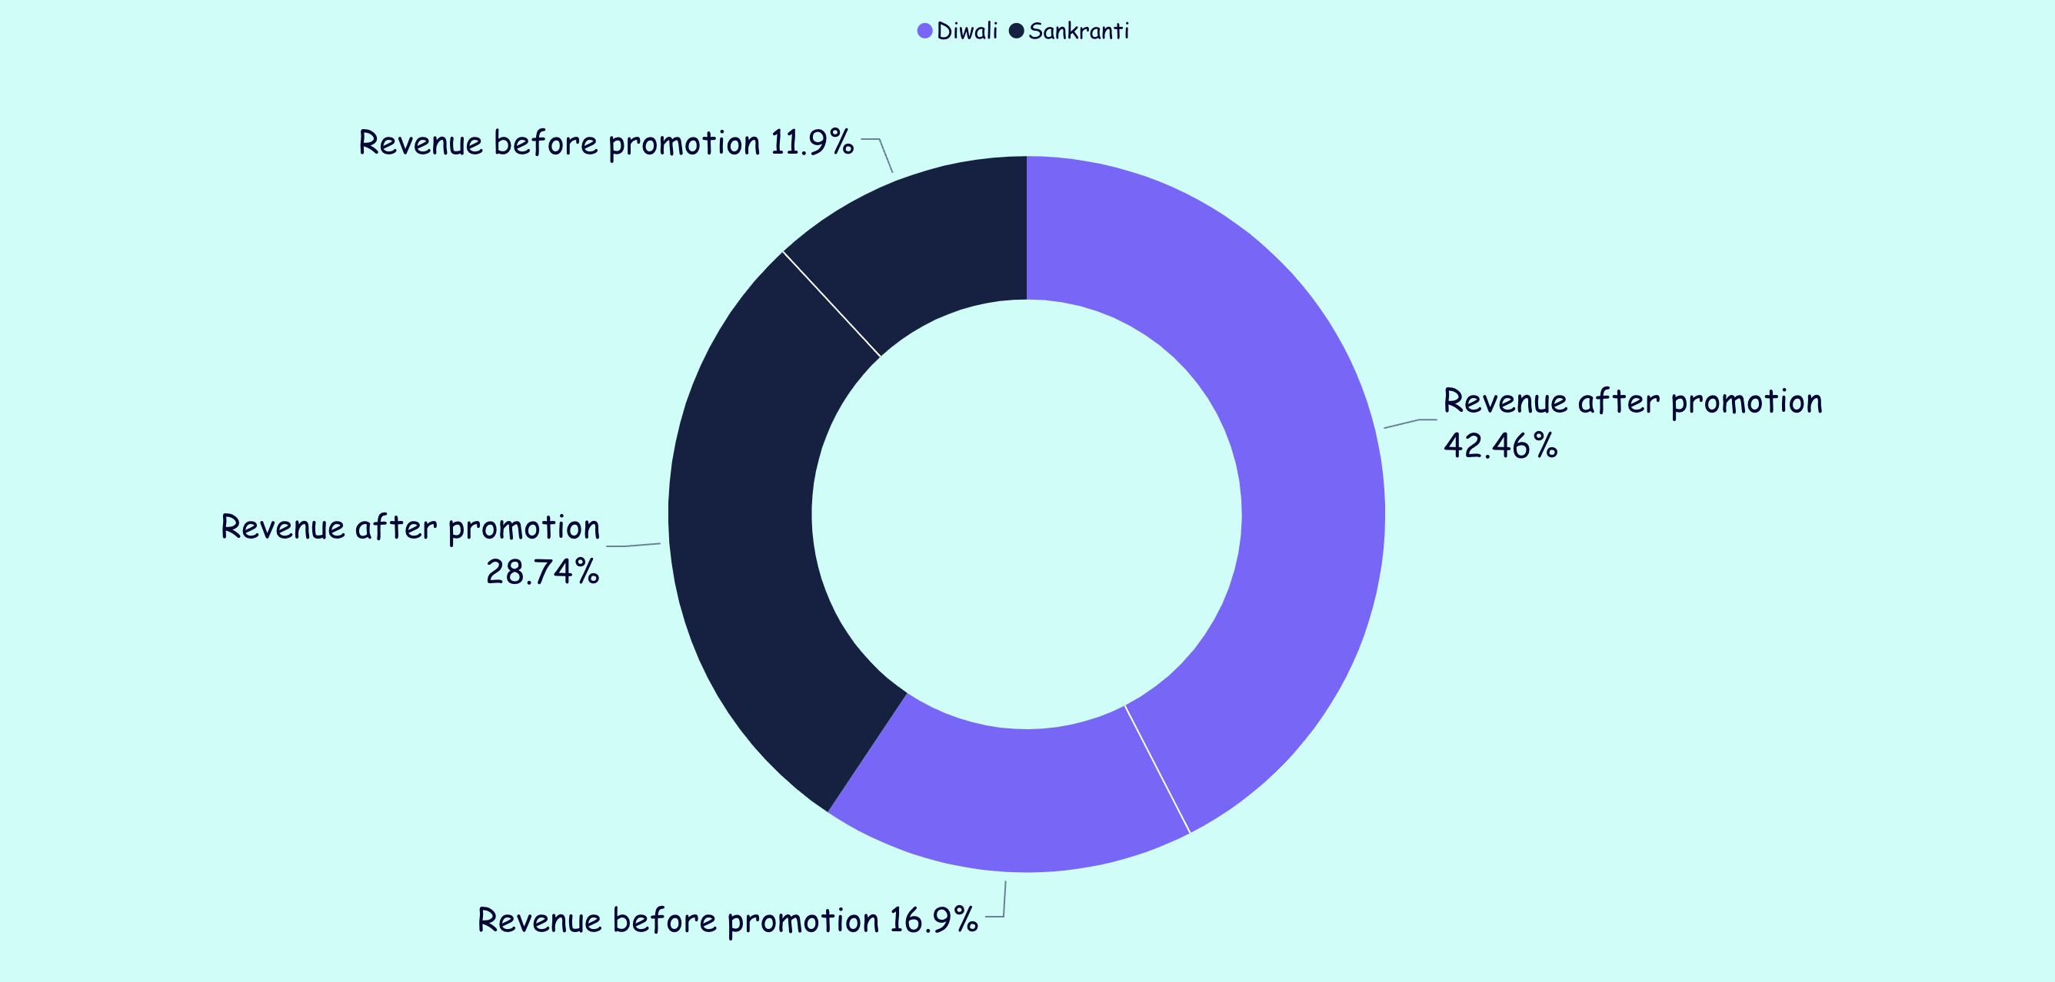
Business Request 3
Campaign name | Revenue before promo | Revenue after promo
Sankranti | 58,127,429 | 140,403,941
Diwali | 82,573,759 | 207,456,209
Financial Impact of both the promotions are shown with a table and a chart.

Slide 7
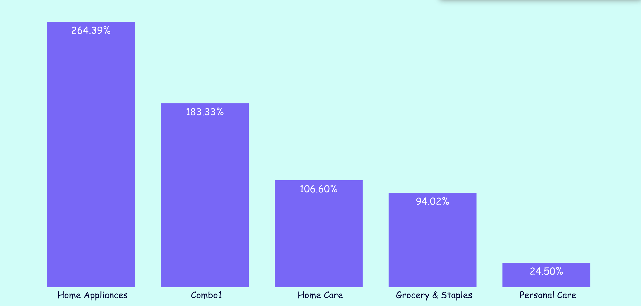
Business Request 4
Category wise success and impact of the promotion is showed in the graph as well as the table.
ISU% - Percentage difference between quantity sold before campaign and after campaign
Category | ISU % | Rank order
Home Appliances | 244.23% | 1
Combo1 | 202.36% | 2
Home Care | 79.63% | 3
Personal Care | 31.06% | 4
Grocery & Staples | 18.05% | 5

Slide 8
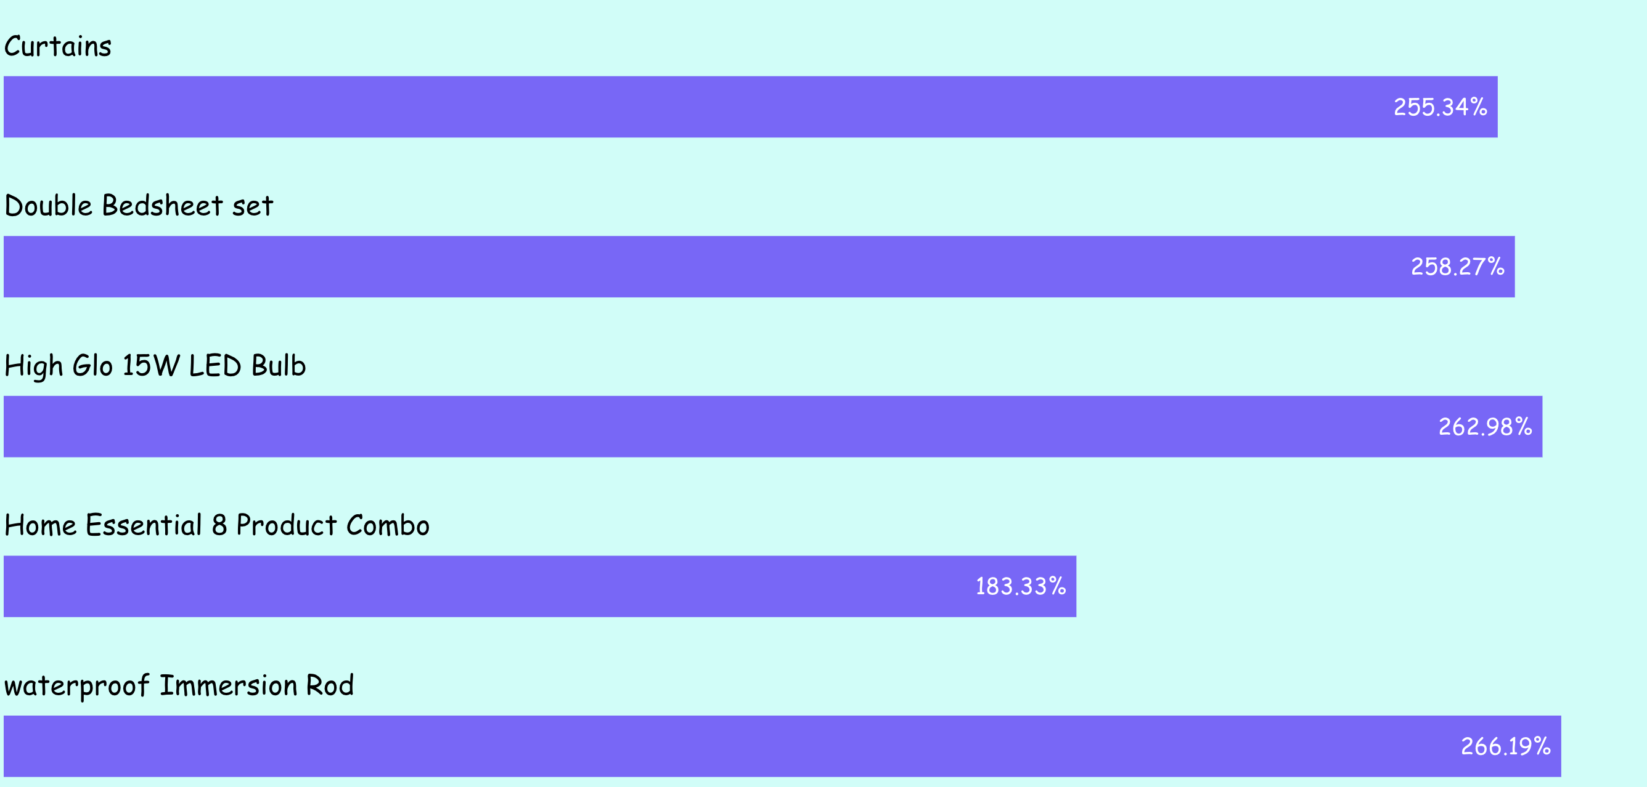
Business Request 5
The most Successful product in terms of Incremental revenue across all campaigns.
IR% - Percentage Increase of Decrease before campaign and after campaign
Product name | category | IR%
Atliq waterproof Immersion Rod | Home Appliances | 266.19%
Atliq High Glo 15W LED Bulb | Home Appliances | 262.98%
Atliq Double Bedsheet set | Home Care | 258.27%
Atliq Curtains | Home Care | 255.34%
Atliq Home Essential 8 Product Combo | Combo1 | 183.33%

Slide 9

Power BI Dashboard Insights

Slide 10
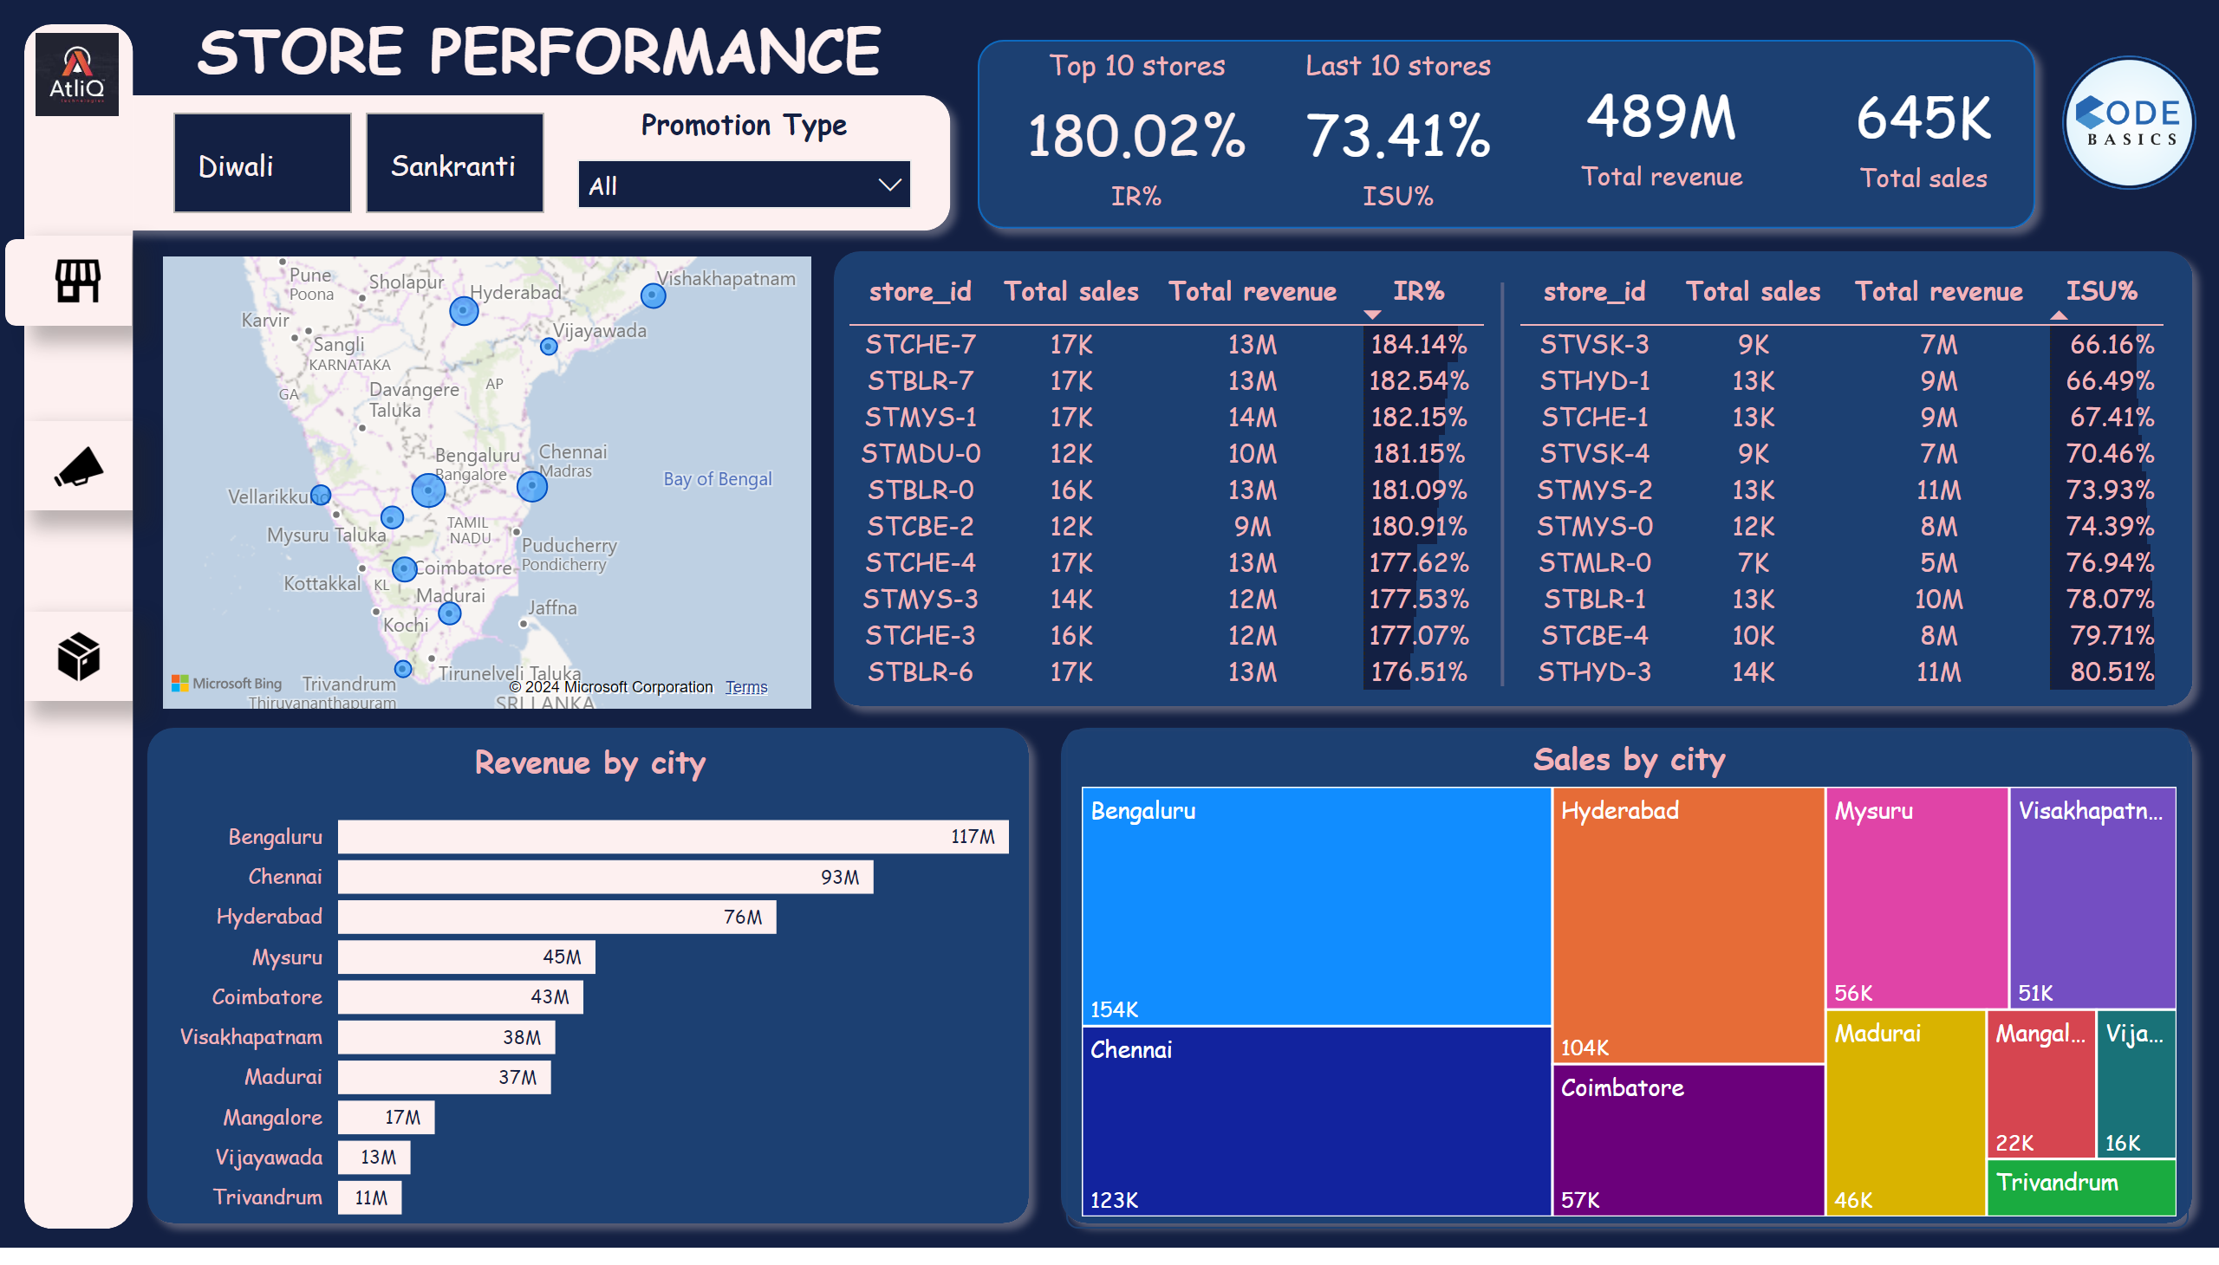
store_analysis
Notes:
tableEx
No alt text provided
shape
No alt text provided
map
No alt text provided
shape
No alt text provided
Top 10 stores
No alt text provided
Last 10 stores
No alt text provided
card
No alt text provided
card
No alt text provided
shape
No alt text provided
shape
No alt text provided
Revenue by city
No alt text provided
Sales by city
No alt text provided
shape
No alt text provided
shape
No alt text provided
advancedSlicerVisual
No alt text provided
shape
No alt text provided
Promotion Type
No alt text provided
actionButton
No alt text provided
shape
No alt text provided
actionButton
No alt text provided
tableEx
No alt text provided
image
No alt text provided
actionButton
No alt text provided
shape
No alt text provided
image
No alt text provided

Slide 11
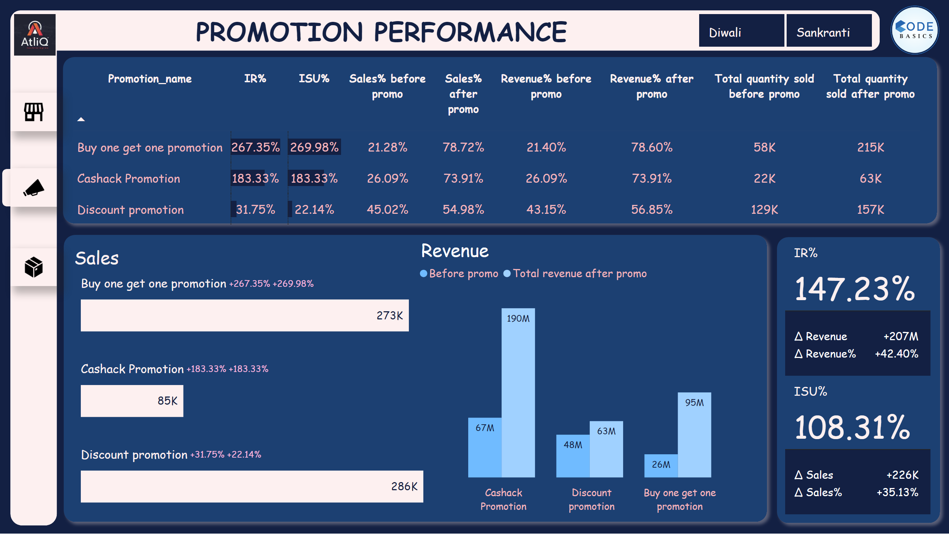
Promotion_analysis
Notes:
shape
No alt text provided
shape
No alt text provided
shape
No alt text provided
shape
No alt text provided
shape
No alt text provided
actionButton
No alt text provided
actionButton
No alt text provided
tableEx
No alt text provided
shape
No alt text provided
clusteredBarChart
No alt text provided
shape
No alt text provided
clusteredColumnChart
No alt text provided
cardVisual
No alt text provided
shape
No alt text provided
shape
No alt text provided
advancedSlicerVisual
No alt text provided
image
No alt text provided
actionButton
No alt text provided
image
No alt text provided

Slide 12
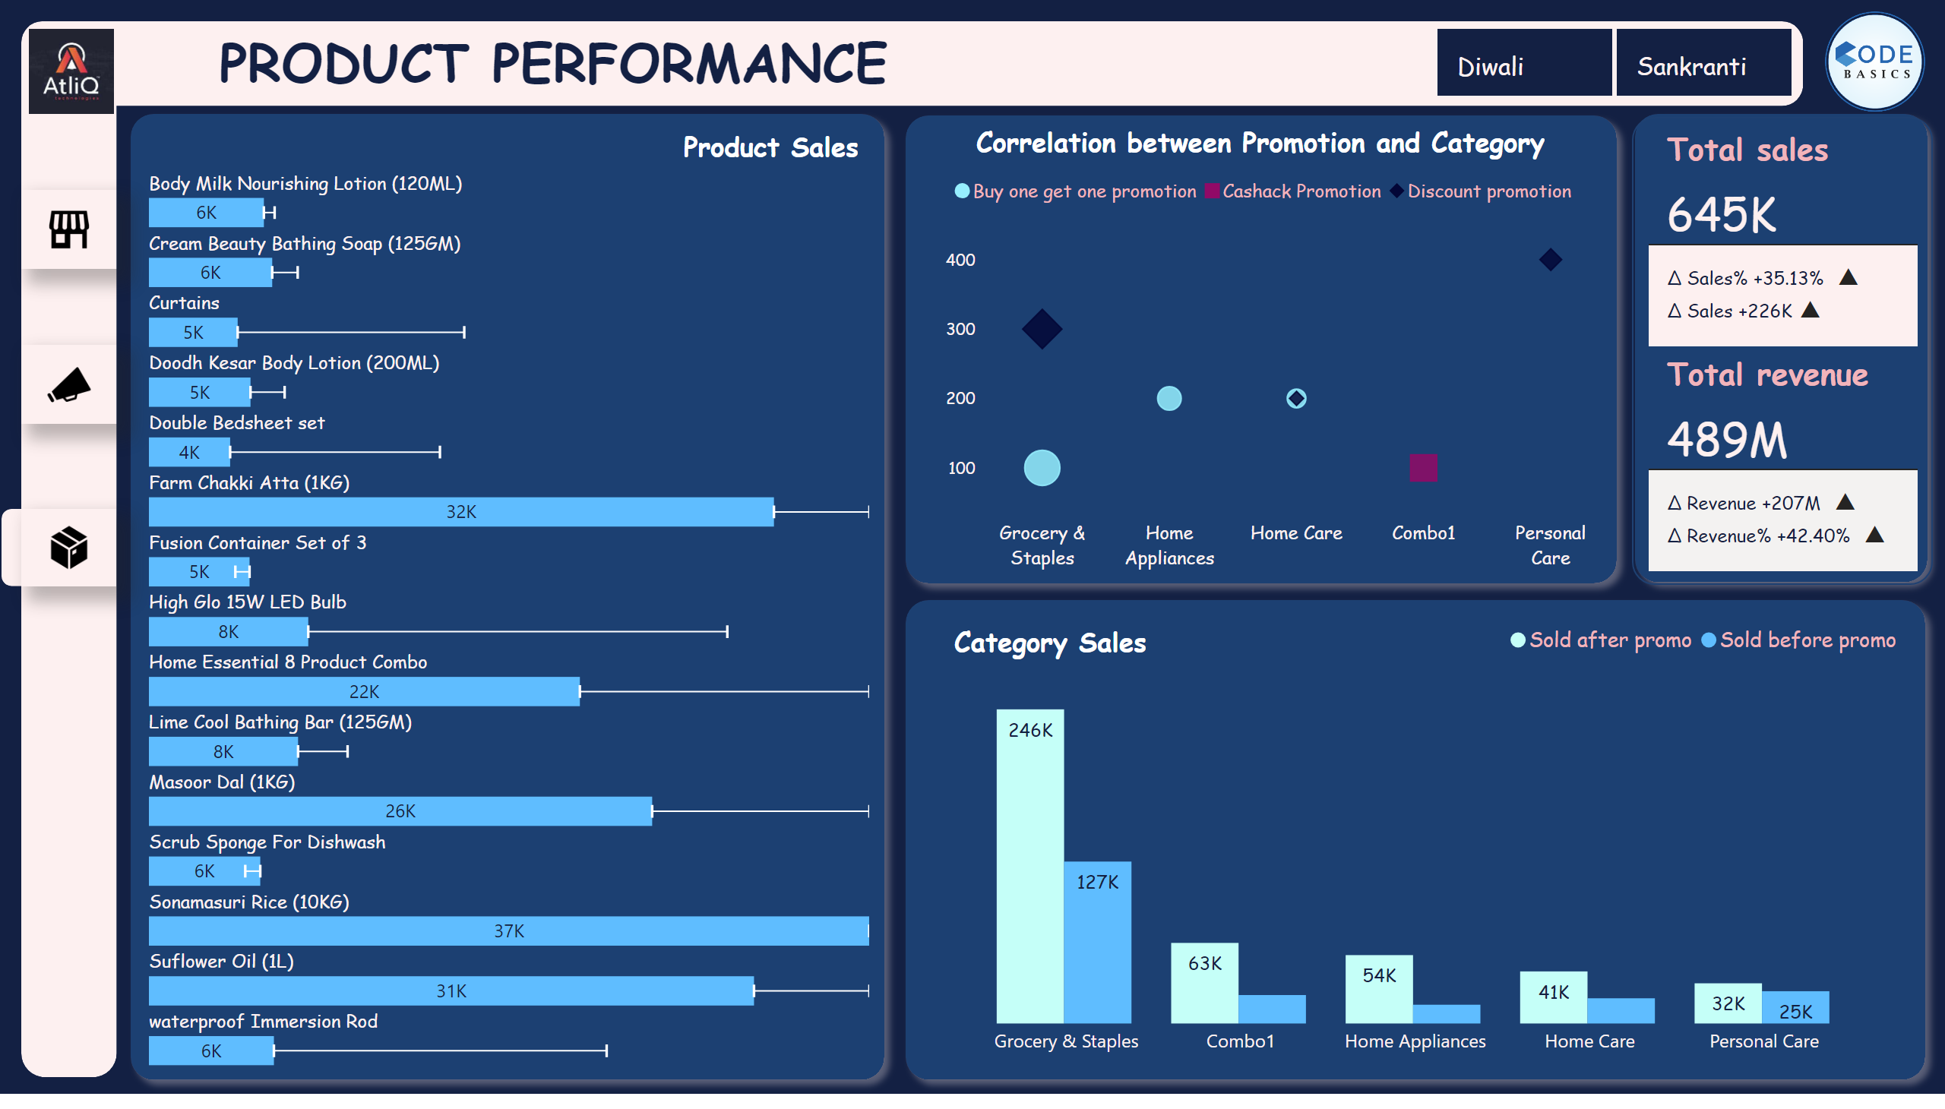
Product analysis
Notes:
actionButton
No alt text provided
shape
No alt text provided
actionButton
No alt text provided
shape
No alt text provided
actionButton
No alt text provided
shape
No alt text provided
cardVisual
No alt text provided
shape
No alt text provided
clusteredBarChart
No alt text provided
shape
No alt text provided
shape
No alt text provided
shape
No alt text provided
clusteredColumnChart
No alt text provided
shape
No alt text provided
shape
No alt text provided
image
No alt text provided
scatterChart
No alt text provided
shape
No alt text provided
advancedSlicerVisual
No alt text provided
shape
No alt text provided
image
No alt text provided

Slide 13
Recommendations and Insights
Metropolitan Dominance:
The metropolitan cities of Bangalore, Chennai, and Hyderabad emerge as clear frontrunners, boasting a higher store count, increased sales volume, and substantial revenue generation. Notably, the combined revenue from these three cities eclipses that of the remaining seven cities.
Strategic Focus:
Given the robust performance of Bangalore, Chennai, and Hyderabad, a strategic emphasis on these key metropolitan areas is recommended. Prioritizing targeted campaigns in these cities presents a valuable opportunity to augment sales further.
Promotional Effectiveness:
"Buy One, Get One Free" (BOGOF) promotions exhibit superior performance, boasting the highest incremental revenue percentage and incremental sales unit percentage when contrasted with cashback and discount promotions.
Sales Hierarchy:
In the realm of sales, discount promotions take the lead, closely followed by BOGOF, with cashback promotions trailing. This hierarchy offers a nuanced understanding of the effectiveness of each promotional strategy.
Revenue Dynamics:
Remarkably, cashback promotions emerge as the most lucrative, yielding nearly three times more revenue than promotions without incentives. This insight underscores the significance of considering revenue dynamics in promotional planning.
Product Performance:
Certain products, including Curtains, Double Bedsheet Sets, High Glo 15W LED Bulbs, and Waterproof Immersion, exhibit a remarkable threefold increase in sales post-promotion. These products, having demonstrated strong market response, present promising candidates for enhanced promotional offers in future campaigns.
Forward Strategy:
Armed with these insights, the forthcoming campaign strategy can be refined by directing more resources towards the top-performing products and leveraging the effectiveness of BOGOF promotions, particularly in the high-performing metropolitan markets.

Slide 14
THANK YOU
Presented by
Sachin Kumar
AKA Peter Pandey

